Slide 1
Chapter 20
How to host a database with AWS

Slide 2
Objectives
Applied
Use AWS to create a MySQL RDS instance that’s publicly accessible.
Use AWS to add a firewall rule for your IP address to your RDS instance.
Use MySQL Workbench to connect to an RDS instance, run scripts to create databases on that instance, and run SQL statements against those databases.
Use AWS to back up and restore an RDS database.
Use AWS to delete an RDS database.

Slide 3
Objectives (continued)
Knowledge
In general terms, explain how cloud computing works.
Describe how Amazon uses Elastic Compute Cloud (EC2) and Relational Database Service (RDS) to implement cloud computing.
Explain what a database instance is in the Amazon cloud.
Explain what a VPC is in the Amazon cloud.
Describe how firewall rules and security groups are used to control access to RDS instances, and the difference between inbound and outbound rules.
Describe the difference between Amazon’s built-in backups and backup plans.
Explain what a snapshot is and when you might create one.
Describe two situations when you might want to restore a database instance.

Slide 4
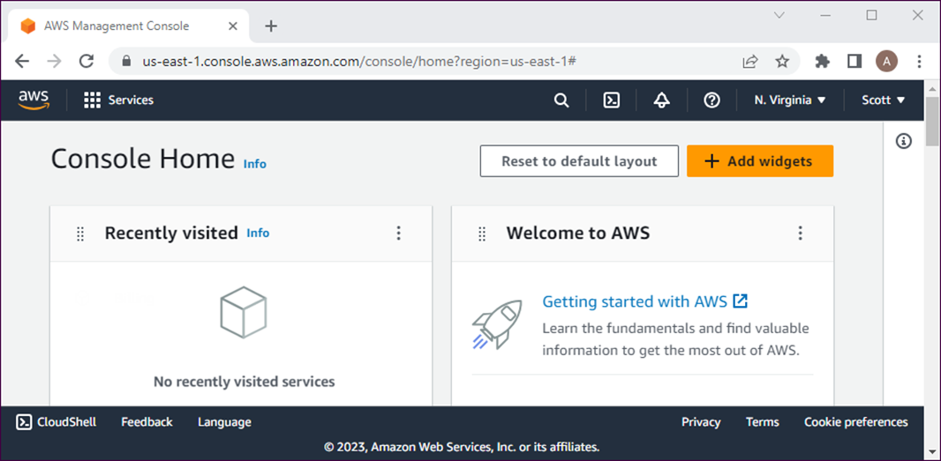
The AWS portal
aws.amazon.com
The AWS Management Console

Slide 5
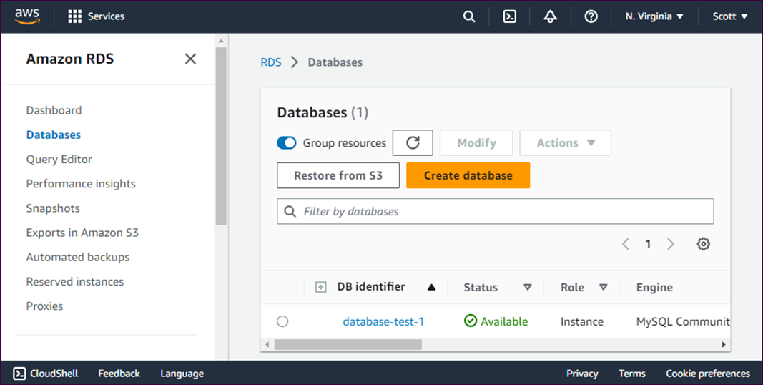
The Amazon RDS Databases page

Slide 6
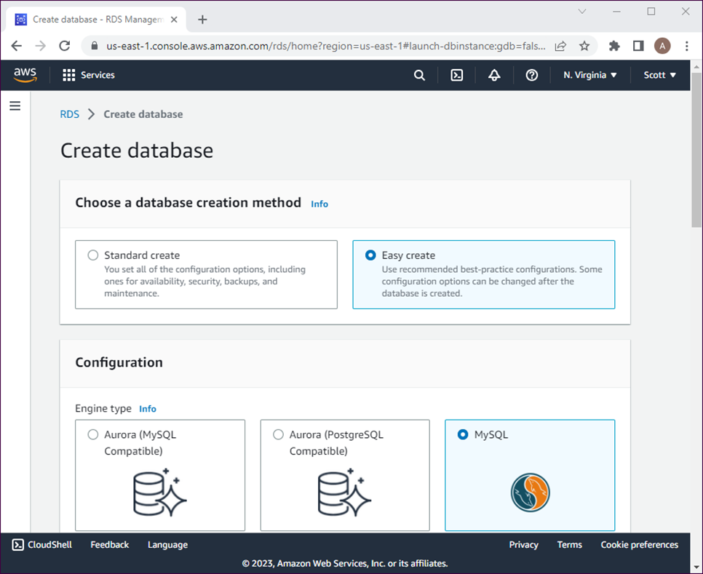
The page for creating a MySQL RDS instance

Slide 7
How to create a free MySQL RDS instance
Log in to the AWS Management Console, and navigate to the RDS Databases page.
Click the “Create database” button.
Select “Easy create” for the database creation method.
Select MySQL for the engine type.
Select “Free tier” for the DB instance size.
Enter a name for the DB instance identifier.
Enter a master password you can easily remember.
Click the “Create database” button.

Slide 8
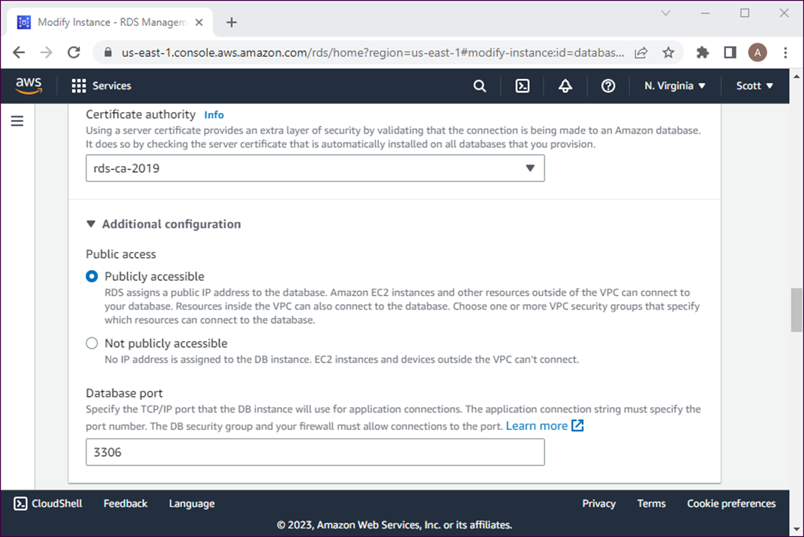
The page for configuring an RDS instance

Slide 9
How to modify an RDS instance so it’s publicly accessible
Navigate to the RDS Databases page.
Click the name of the instance to display information about it.
Click the Modify button to display the modifiable settings.
Expand the “Additional configuration” heading in the Connectivity section.
Select “Publicly Accessible” for the “Public access” option.
Click the Continue button at the bottom of the page.
Confirm the changes on the screen that’s displayed, select “Apply immediately”, and click the “Modify DB instance” button.

Slide 10
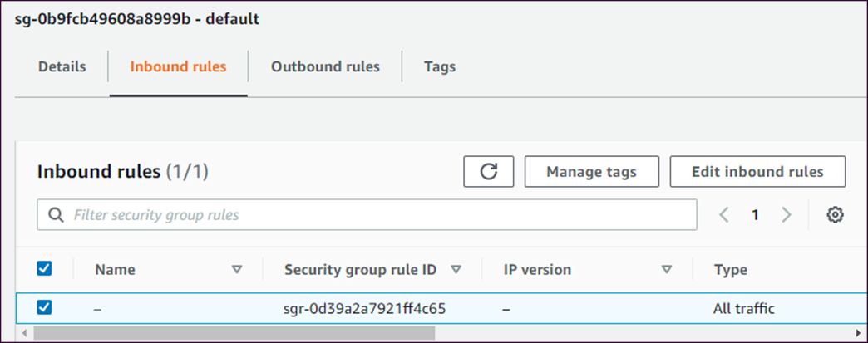
How to add a firewall rule for your IP address
Click the name of your instance on the RDS Databases page.
In the “Security group rules” section, click the security group with “Inbound” in the Type column to display information about that group.
Click the “Inbound rules” tab for the security group to display the default inbound rule:

Slide 11
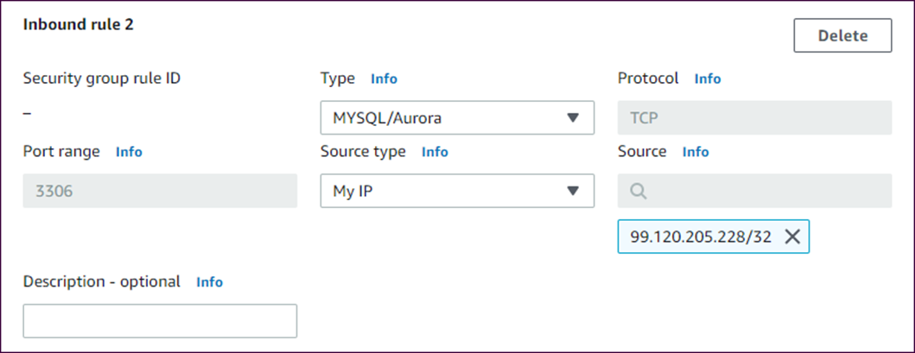
How to add a firewall rule for your IP address (continued)
Click the “Edit inbound rules” button, and click the “Add rule” button in the “Edit inbound rules” page that’s displayed.
Click the “Add rule” button to display controls for adding a rule:
Select MYSQL/Aurora from the Type dropdown.
Select “My IP” from the “Source type” dropdown.
Click the “Save rules” button.

Slide 12
Terms to know about AWS
Amazon Web Services (AWS)
Amazon Relational Database Service (RDS)
Database (DB) instance
Virtual private cloud (VPC)
Firewall rule
Security rule

Slide 13
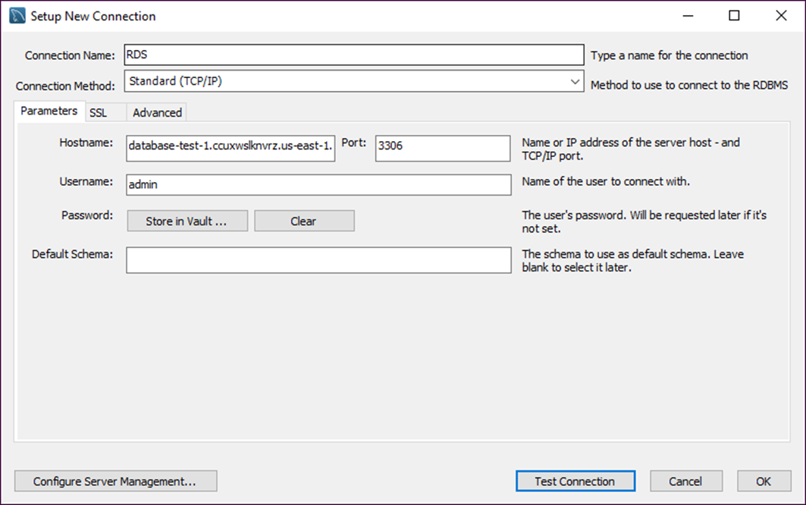
The settings for an RDS connection

Slide 14
How to connect to an RDS instance
Click the name of the instance on the RDS Databases page.
Copy the complete endpoint string in the Connectivity & Security section.
Open MySQL Workbench, display the Home tab, and click the + button to the right of MySQL Connections to display the Setup New Connection dialog box.
Enter a descriptive connection name.
Replace the hostname with the endpoint string you copied in step 2.
Change the username to “admin”.
Click the “Store in Vault...” button and enter your AWS password when prompted.
Click the Test Connection button to be sure the connection works.

Slide 15
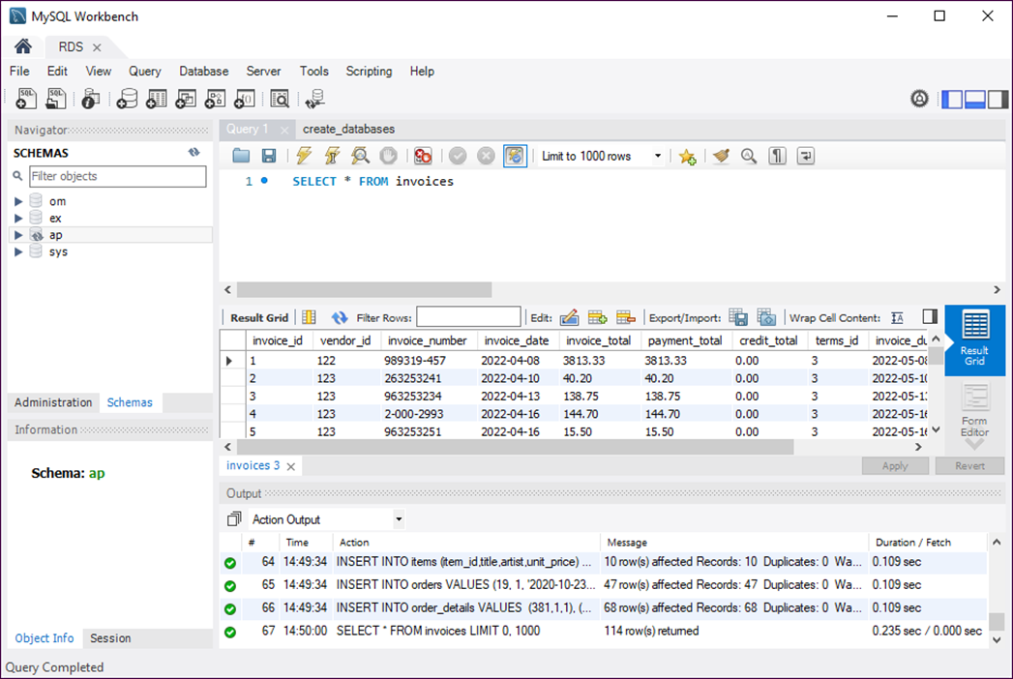
Workbench after running a script and a SQL statement

Slide 16
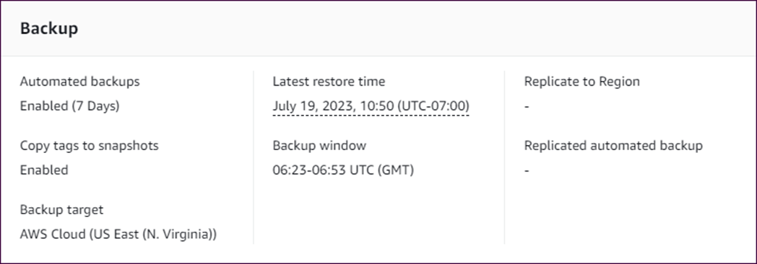
The built-in backup settings for an instance
How to display the built-in backup settings
Click the name of the instance on the RDS Databases page.
Click the “Maintenance & backups” tab, and scroll down to the Backup section.

Slide 17
How to modify the built-in backup settings
Click the name of the instance on the RDS Databases page.
Click the Modify button on the page that’s displayed, and change the backup settings as necessary.
Click the Continue button, confirm the changes on the page that’s displayed, and click the “Modify DB instance” button.

Slide 18
How to create a backup plan
Navigate to the AWS Backup page, and click the “Create Backup plan” button.
Select the “Start with a template” backup plan option, select a template plan, and enter a unique, descriptive name for the backup plan.
Click the “Create plan” button at the bottom of the page.
Click “Backup plans” in the sidebar, and click the plan you just created.
Click the “Assign resources” button on the page that’s displayed.
Enter a unique, descriptive name for the resource assignment.
Select the “Include specific resource types” radio button, select RDS as the resource type, and select your RDS instance.
Click the “Assign resources” button.

Slide 19
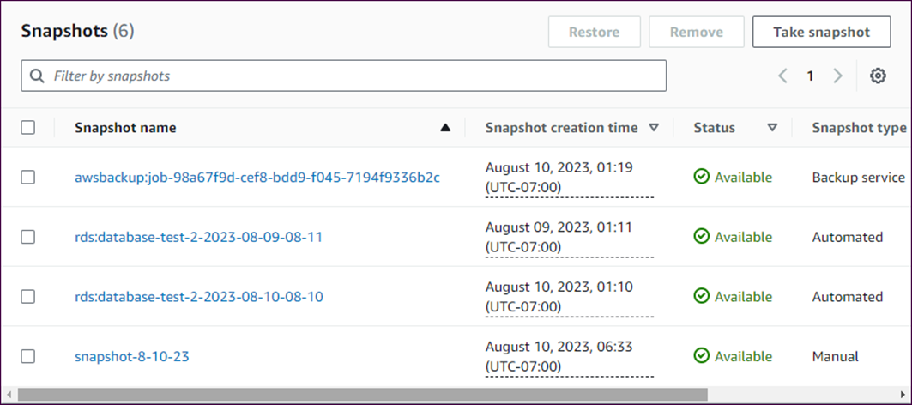
The backups and snapshots for an instance

Slide 20
How to take a snapshot of a database instance
Navigate to the RDS Databases page and click the name of the database instance you want to take a snapshot of.
Click the “Maintenance & backups” tab below the Summary section.
Scroll to the Snapshots section of the page and click the “Take snapshot” button.
Enter a unique, descriptive name for the snapshot and click the Take Snapshot button.

Slide 21
How to delete one or more snapshots
Navigate to the “Maintenance & backups” tab on the page for the database instance that has snapshots you want to delete.
Scroll to the Snapshots section, select the check boxes for the snapshots you want to delete, and click the Remove button.
Click the Delete button in the dialog box that’s displayed.

Slide 22
How to restore a database instance from a backup or snapshot
Navigate to the “Maintenance & backups” tab on the page for the database instance you want to restore.
Scroll to the Snapshots section, and select the checkbox for the snapshot or backup you want to restore.
Click the Restore button to display the Restore Snapshot page.
Enter the name of the database instance in the Settings section, select Yes for the “Public access” option in the Connectivity section, and click the “Restore DB instance” button.

Slide 23
Terms to know about backups
Backup plan
Snapshot

Slide 24
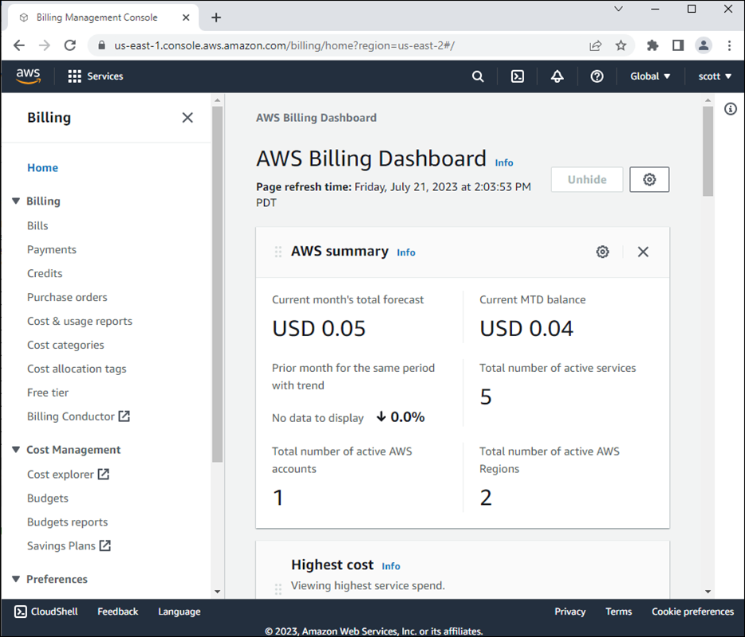
The AWS Billing Dashboard

Slide 25
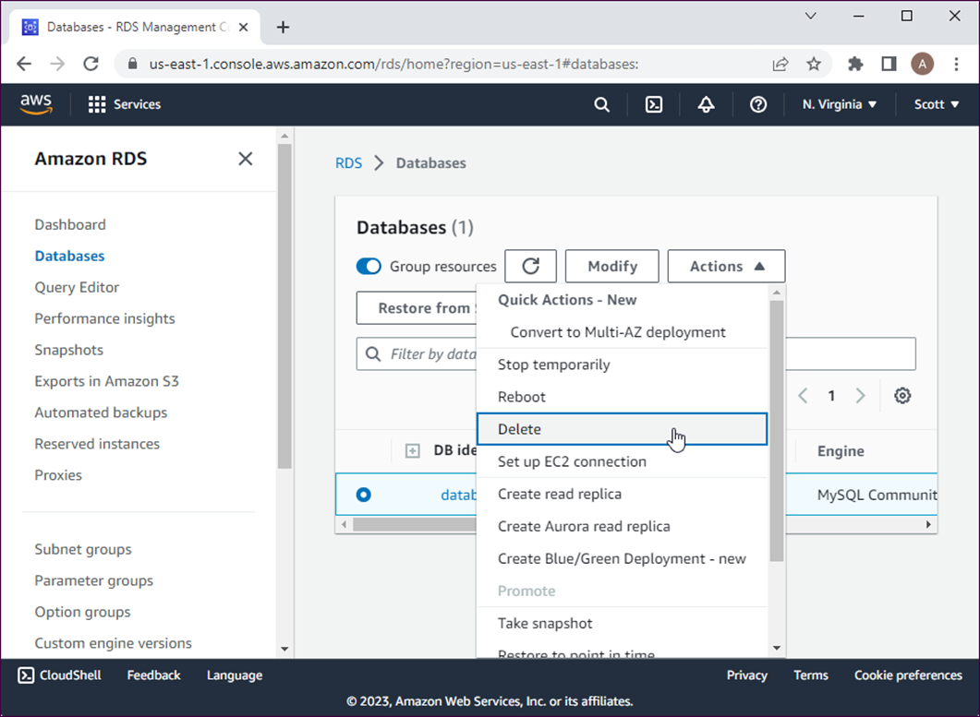
The menu for deleting a database

Slide 26
How to delete an RDS database
Select the instance you want to delete from the RDS Databases page by clicking the circle to the left of its name.
Select Delete from the Actions drop-down menu to display a Delete dialog box.
Uncheck the “Create final snapshot” and “Retain automated backups” options if you won’t need the data in the database again.
Check the “I acknowledge…” option and type “delete me” into the text box at the bottom of the dialog box.
Click the Delete button.

